Slide 1



RFID Flap Barrier Gate
Using ESP_32, Servo motor, Oled display and Blynk Integration
Presenting By
Md Ismail Hossain (CSE)
Tawhidul Islam (CSE)
Jannatul ferdaus(irs & gis)

Slide 2
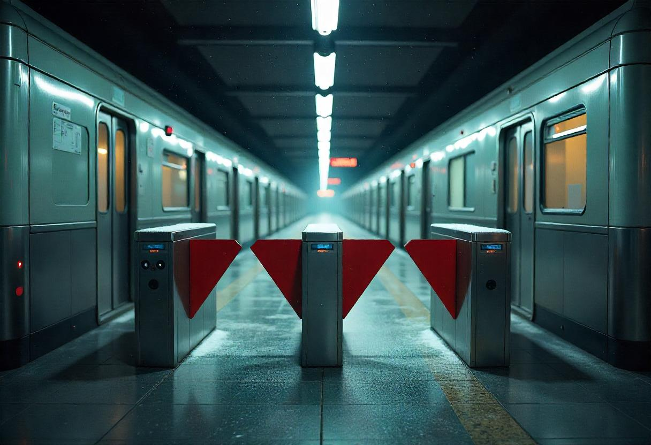
Why do we need flap barrier gate system?
Ensures secure and authorized access.
Automates attendance with real-time logs.
Reduces costs and minimizes human errors

Slide 3
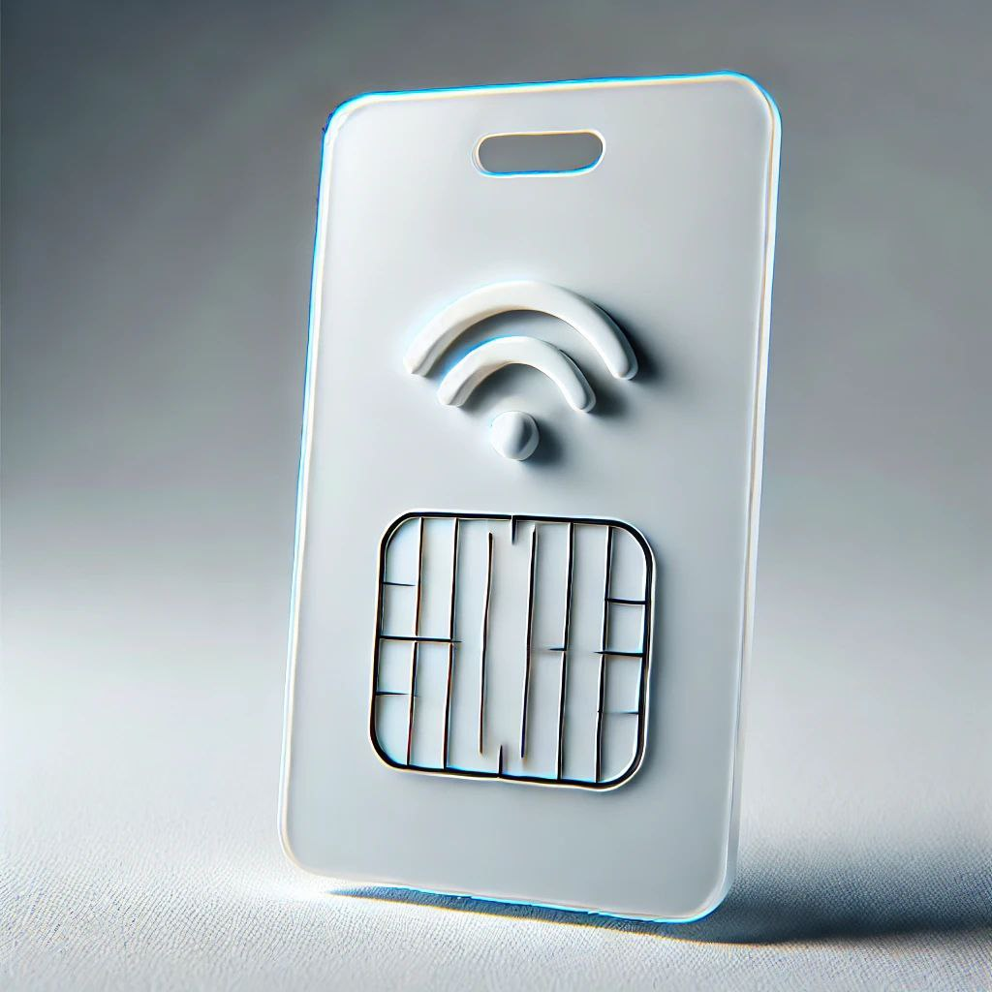
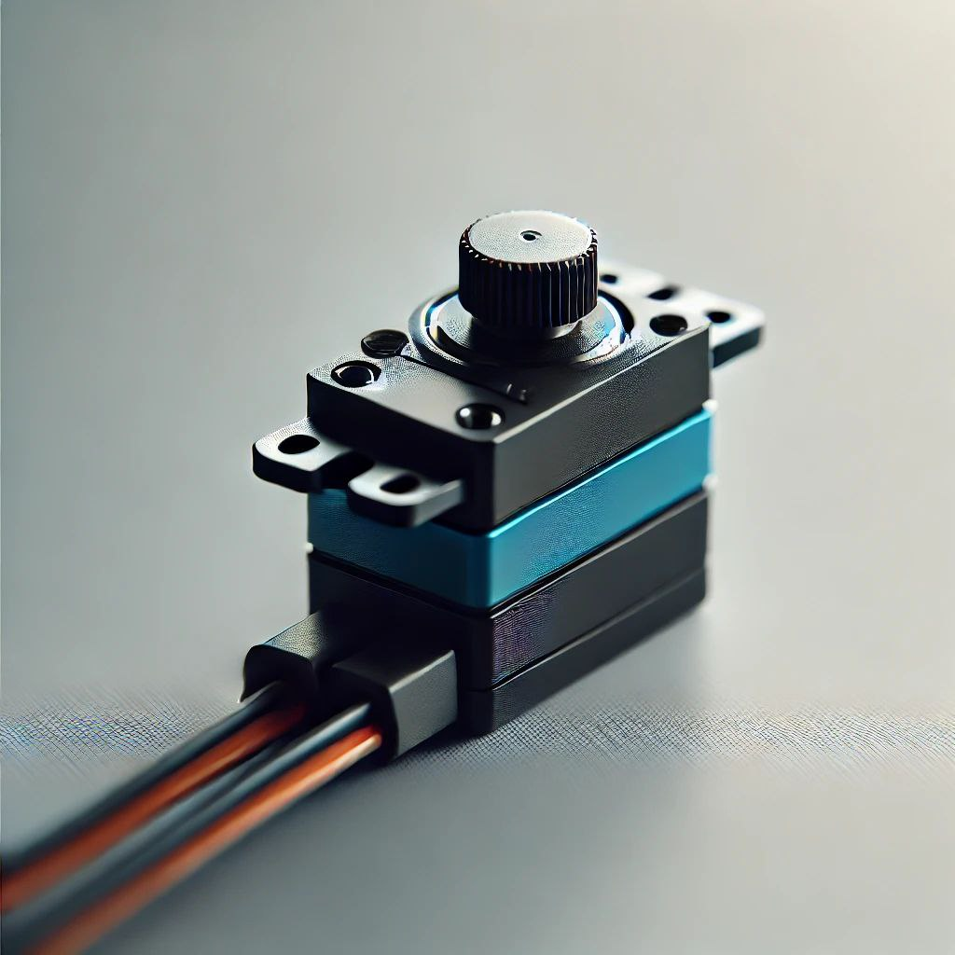
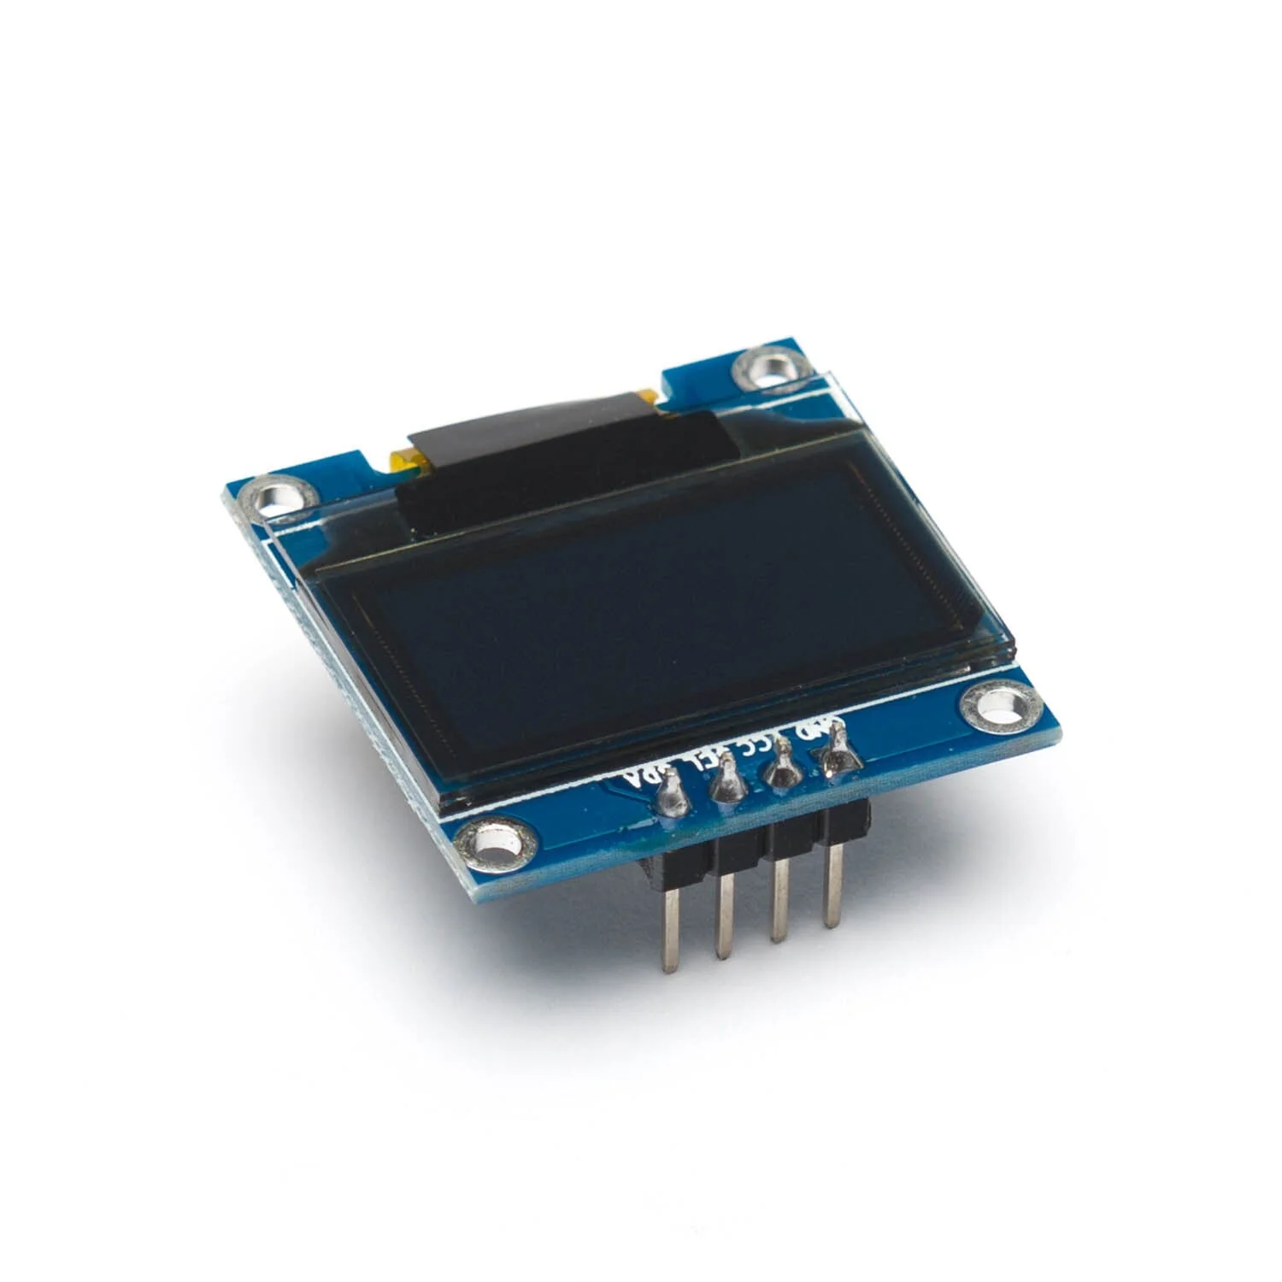
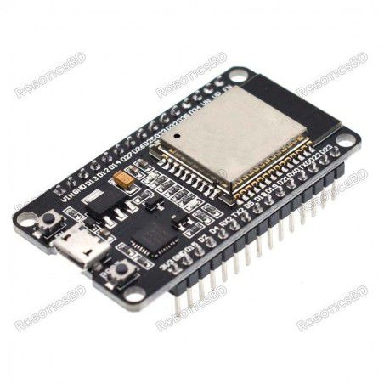
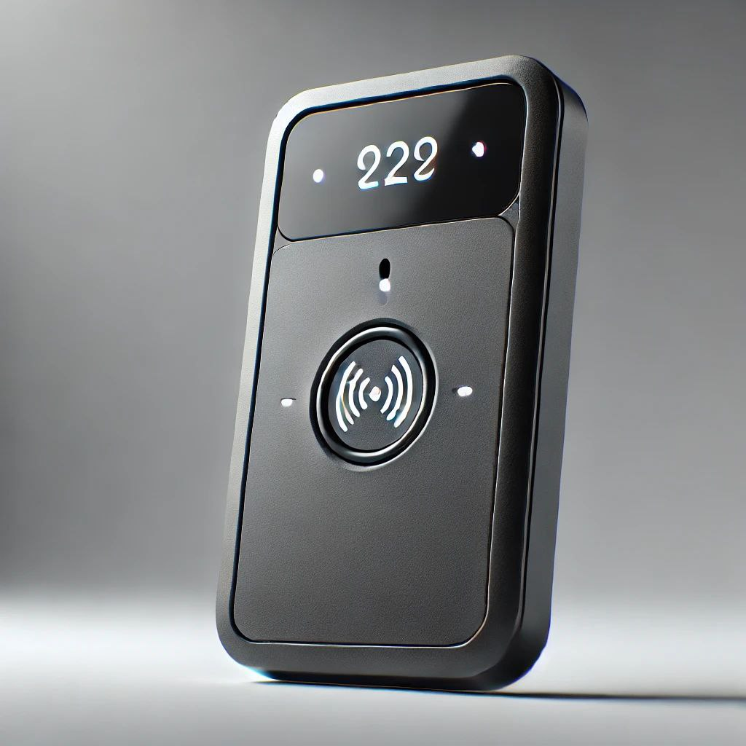
System Component
Key Components:
1. RFID Reader
2.ESP-32
3. Servo Motor
4. OLED display
5. RFID Card
6.LED and Buzzer

Slide 4
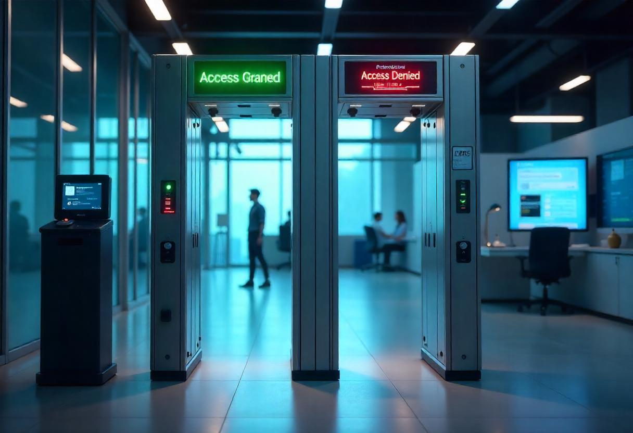
System Workflow
Card Scanning – RFID reader detects and verifies tags.
Gate Control – Opens for valid cards, stays closed for invalid ones.
Data Logging – Entry/exit details stored in real-time.
Alert Triggers – Unauthorized access generates alerts.
Data Visualization – Admins monitor logs via a dashboard.

Slide 5
Implementation Steps
Hardware Setup: Connected ESP-32, RFID reader, Servo motor, LEDs, and buzzer.
RFID Integration: Programmed ESP-32 to read RFID tags and send data.
Firebase Database: Stored user details, access logs, and real-time status.
Blynk Dashboard: Designed a UI to monitor entry logs.
Gate Control Mechanism: ESP-32 processes Servo Motor to open/close the flap gate.

Slide 6
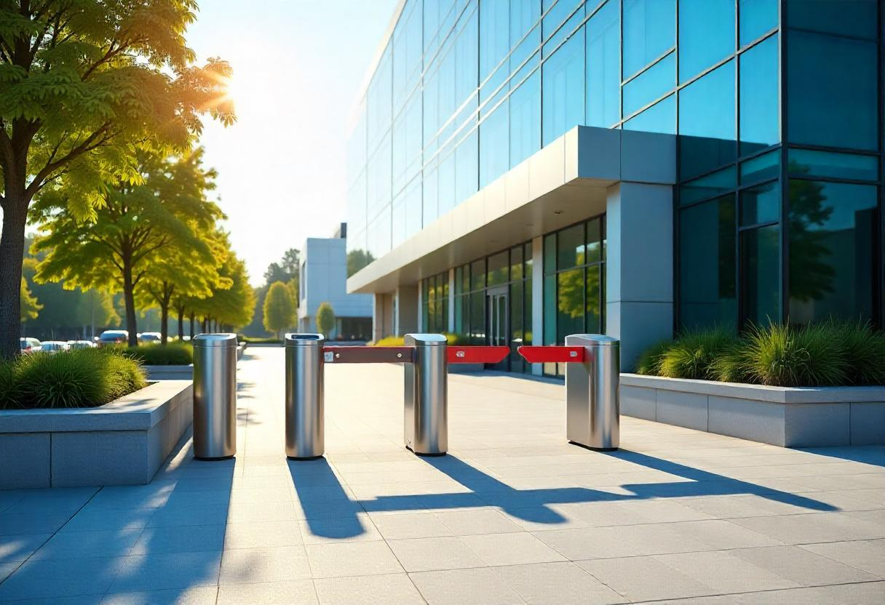
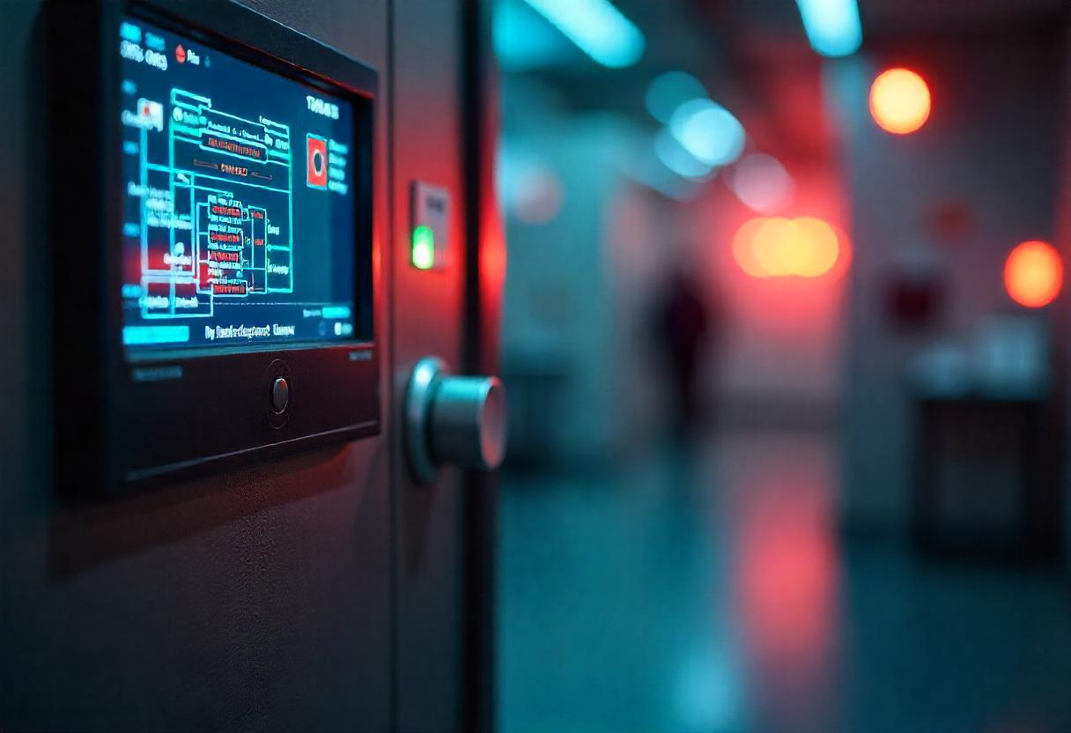
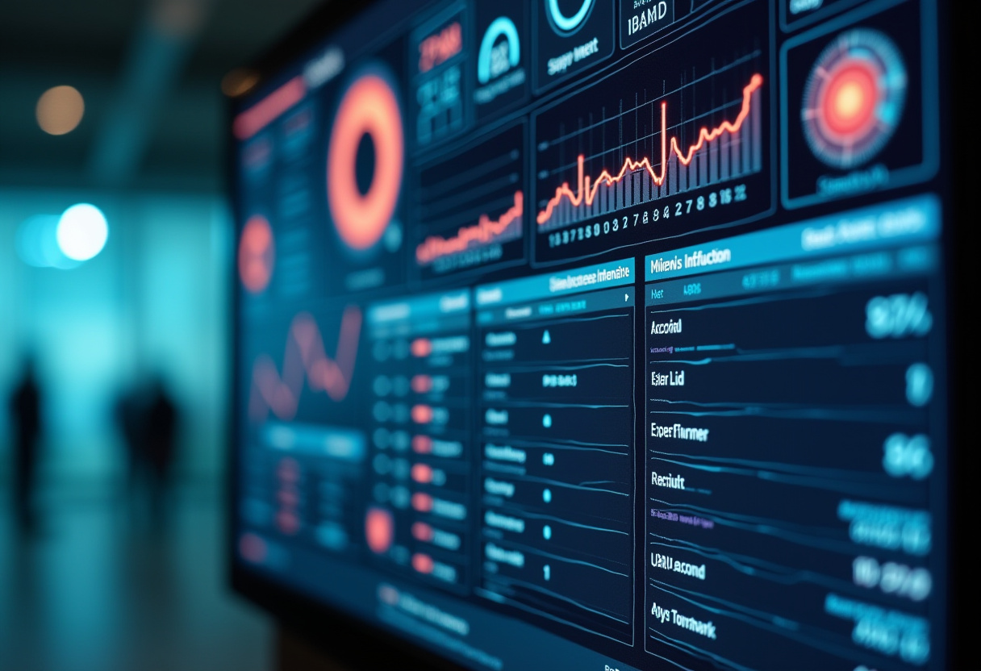
Real-Life Applications
Corporate Offices & IT Parks.
Libraries & Educational Institutions.
Metro Stations & Public Transport.
Airports & Border Security.
Sports Arenas & Event Venues.
Government & Military Facilities.
And 101 Others…

Slide 7
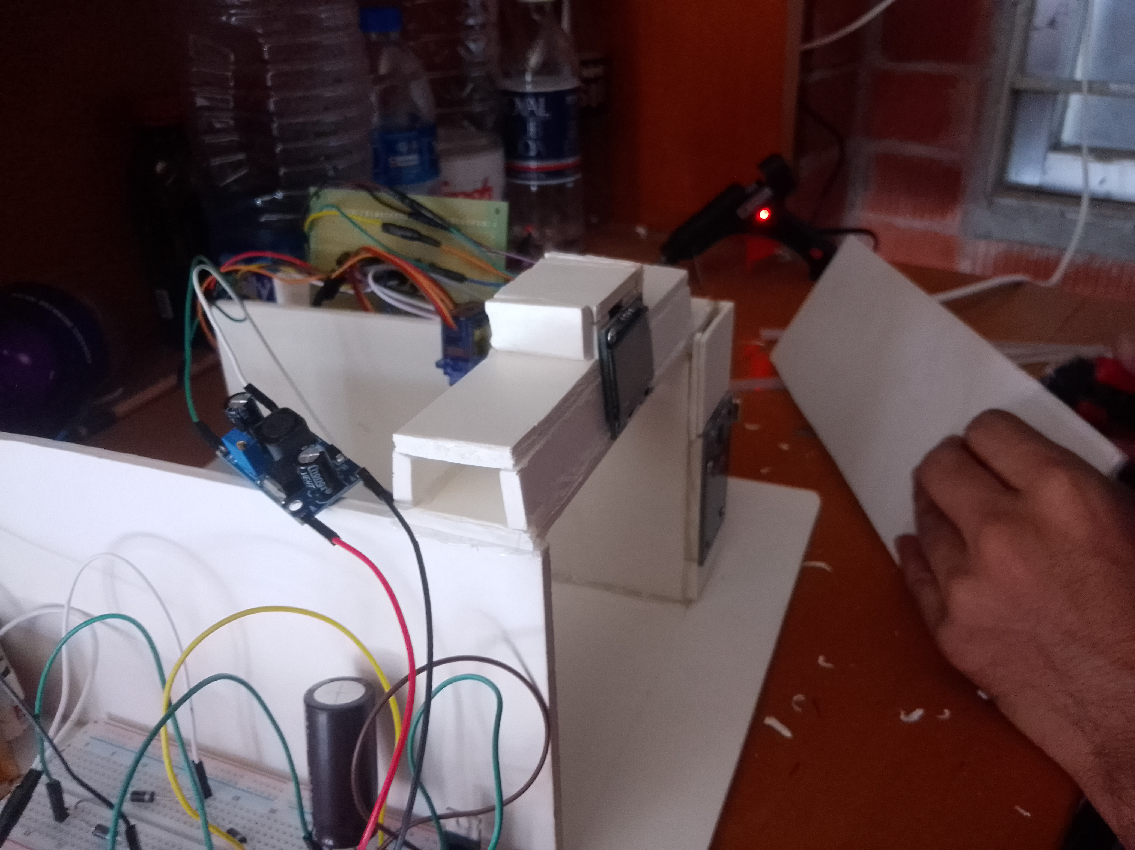
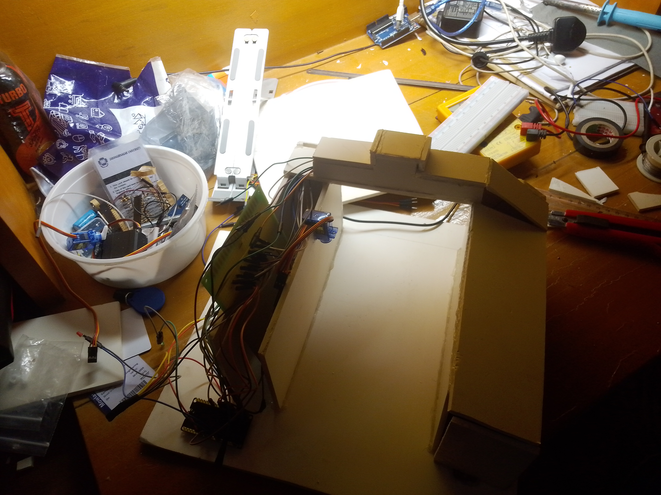
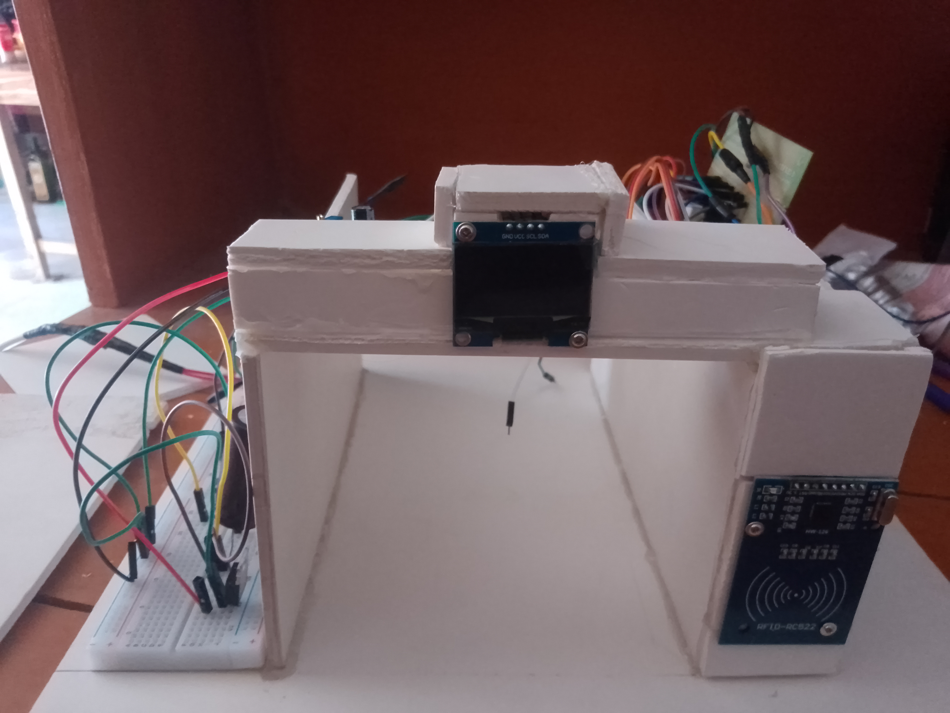
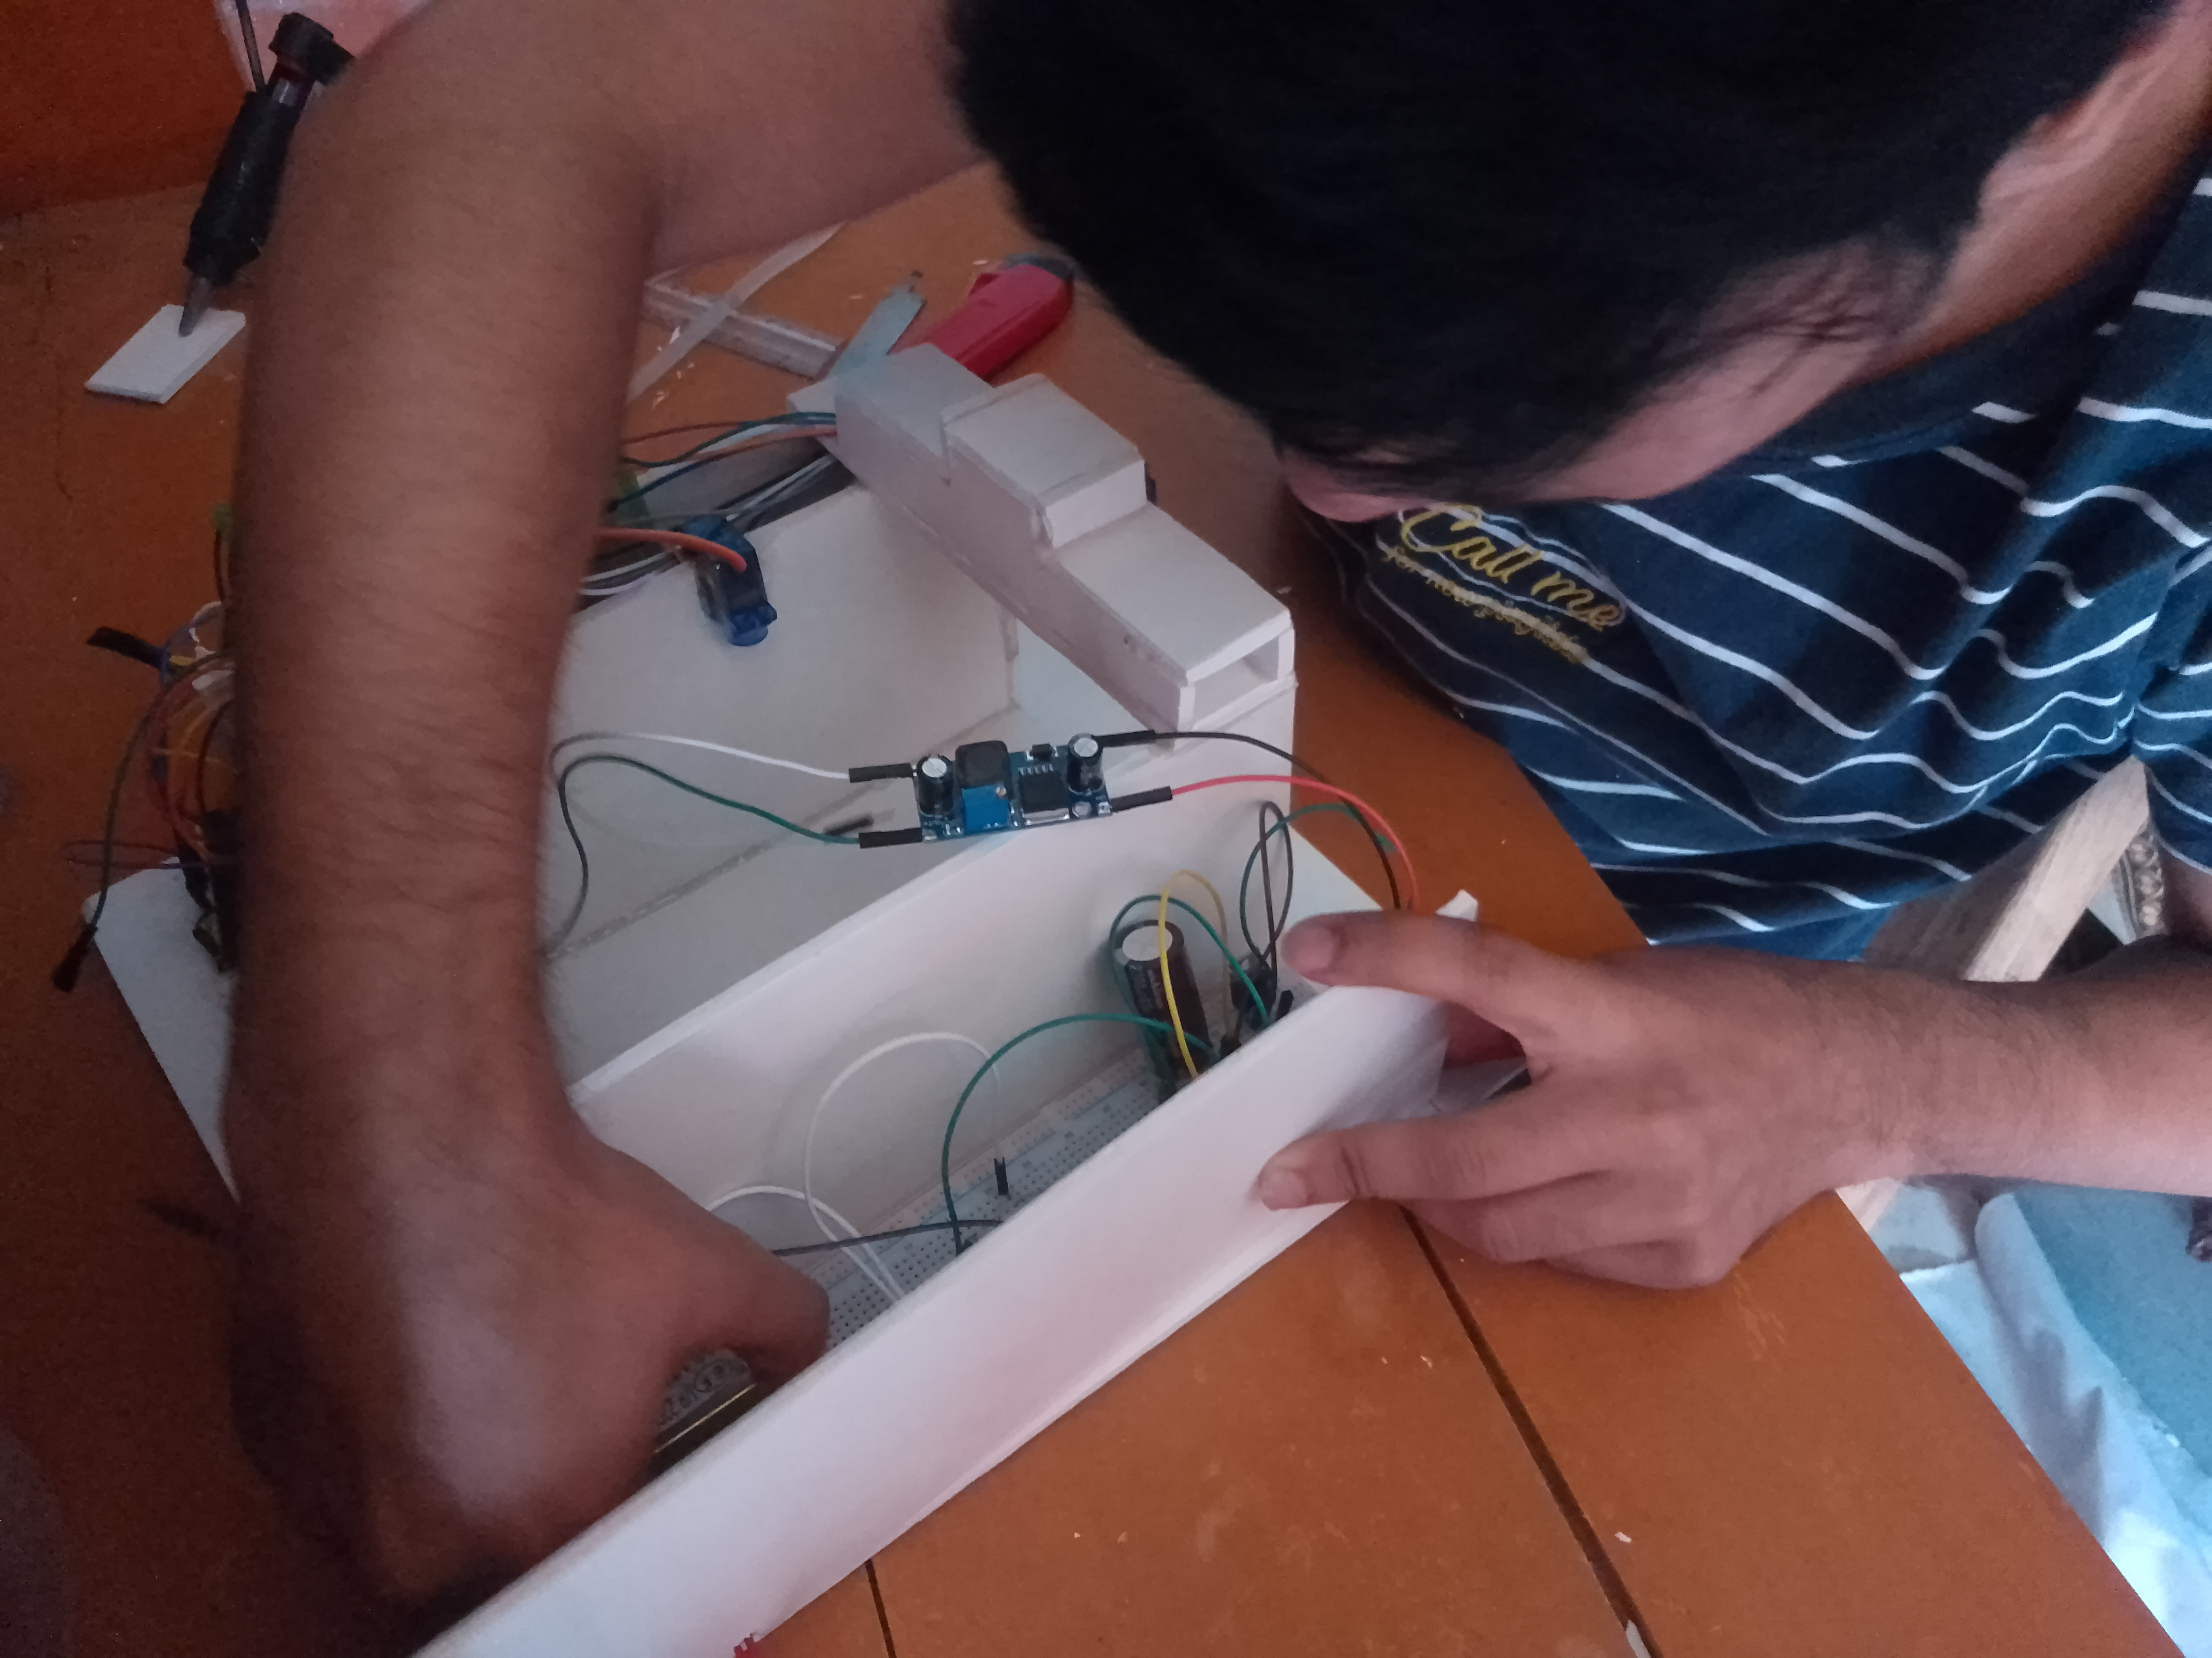
Some Snapshoots

Slide 8
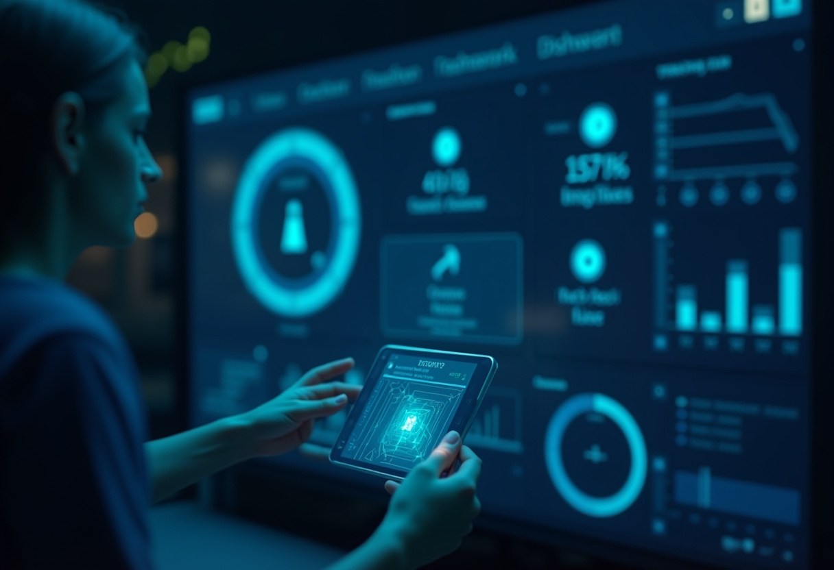
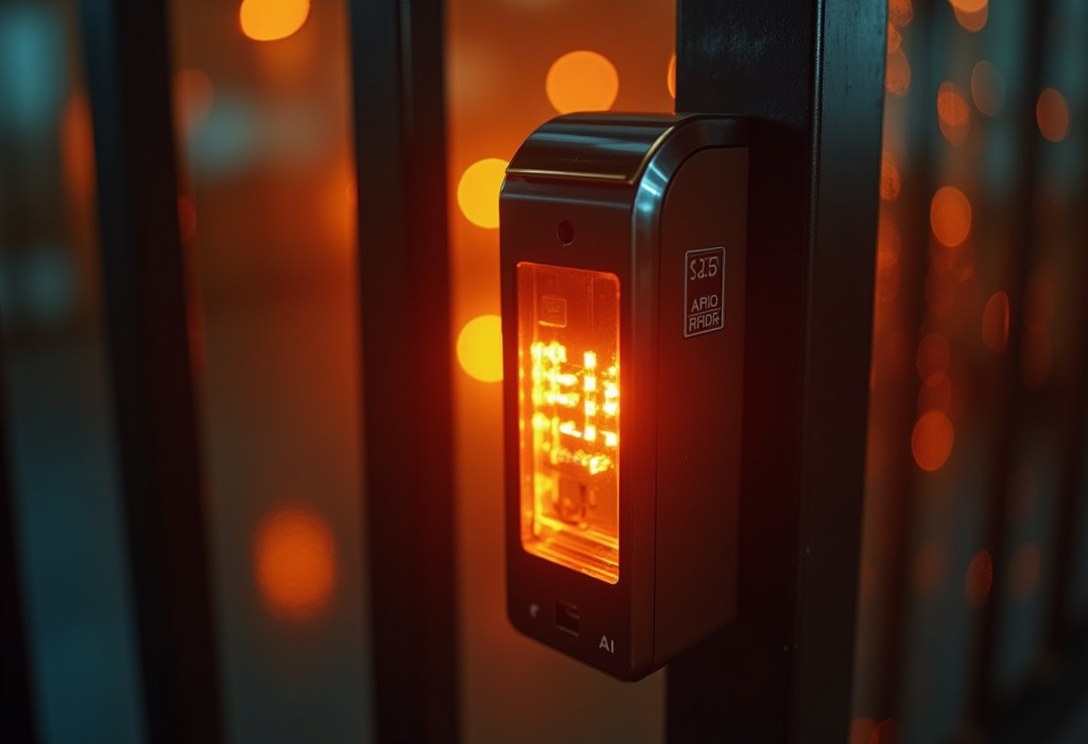

Conclusion
The RFID Flap Barrier Gate ensures secure, automated, and efficient access control.
Real-time monitoring and alerts improve security management.
Ready for future upgrades and new functionalities.

Slide 9
Some Ideas for Advanced Features & Improvements
1. Dual Authentication (RFID + Face Recognition) 2. Access Logs with Mobile Notification
Send real-time Firebase notifications to admin/teacher when a VIP (e.g., professor) enters
Allow users to check their entry/exit logs via a mobile app.
3. Time-Based Access Control
Restrict entry based on schedule (e.g., students can't enter after 10 PM).
Temporary Access Cards: Generate one-time-use RFID access for visitors.

Slide 10


